Slide 1
snapchat stories
Name:
Event:
From the perspective of:
Add Selfie/Snapcode

Slide 2
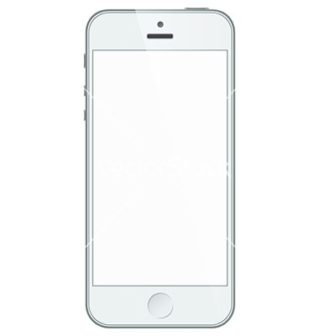
Summary of modern event
Event Description:
Notes:
Comment (slide-up)
Time (slide-right)

Slide 3
Image
+
Caption
Time:
Notes:
Comment (slide-up)
Time (slide-right)

Slide 4
Image
+
Caption
+
Geotag
Time:

Slide 5
Image
+
Caption
+
Doodle
Time:

Slide 6
Image
+
Caption
+
Bitmoji
Time:

Slide 7
Video (10 seconds)
Time:

Slide 8
Memories
Notes:
Memories

